Slide 1
Jesus and Evangelism:
Good Works

Slide 2
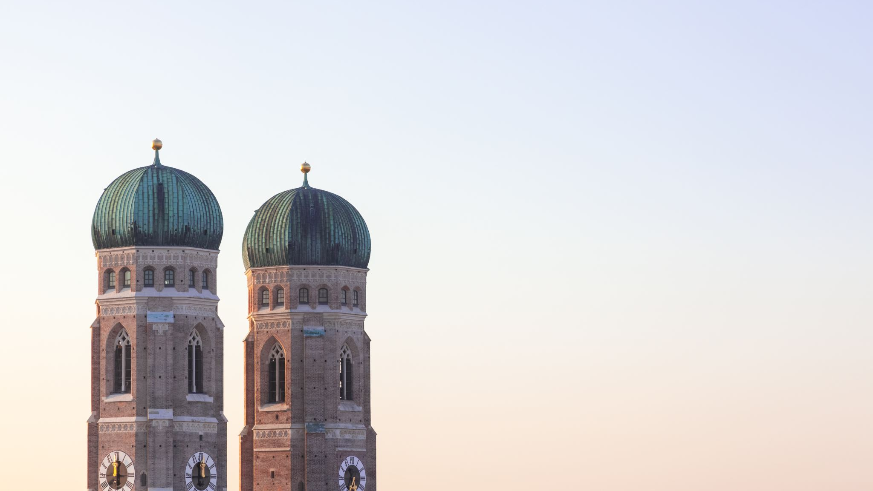
Section One
Jesus’ Example

Slide 3
Jesus brings justice
“Behold my servant, whom I uphold, my chosen, in whom my soul delights. I have put my Spirit upon him; he will bring forth justice to the nations. He will not cry aloud or lift up his voice or make it heard in the street; a bruised reed he will not break, and a faintly burning wick he will not quench; he will faithfully bring forth justice. He will not grow faint or be discouraged till he has established justice in the earth; and the coastlands wait for his law. I am the LORD; I have called you in righteousness; I will take you by the hand and keep you; I will give you as a covenant for the people, a light for the nations, to open the eyes that are blind, to bring out prisoners from the dungeon, from the prison those who sit in darkness.”
– Isaiah 42:1-4, 6-7
“He shall not judge by what his eyes see, or decide disputes by what his ears hear, but with righteousness, he shall judge the poor, and decide with equity for the meek of the earth.“
– Isaiah 11:3-4a (ESV)

Slide 4
Jesus brings jubilee
“The Spirit of the Lord God is upon me because the Lord has anointed me... to bring good news to the poor; he has sent me to bind up the broken-hearted, to proclaim liberty to the captives, and the opening of the prison to those who are bound... to comfort all who mourn... to give them a beautiful headdress instead of ashes, the oil of gladness instead of mourning, the garment of praise instead of a faint spirit...”
- Isaiah 61:1, 2b-3a (ESV)

Slide 5
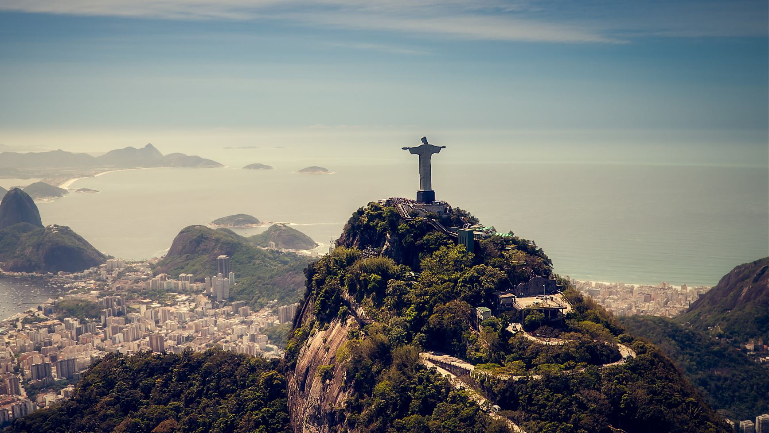
Jesus the Servant
“Jesus knew that the Father had put all things under his power and that he had come from God and was returning to God; so he got up from the meal, took off his outer clothing, and wrapped a towel around his waist. After that, he poured water into a basin and began to wash his disciples' feet, drying them with the towel that was wrapped around him.“
- John 13:3-5

Slide 6
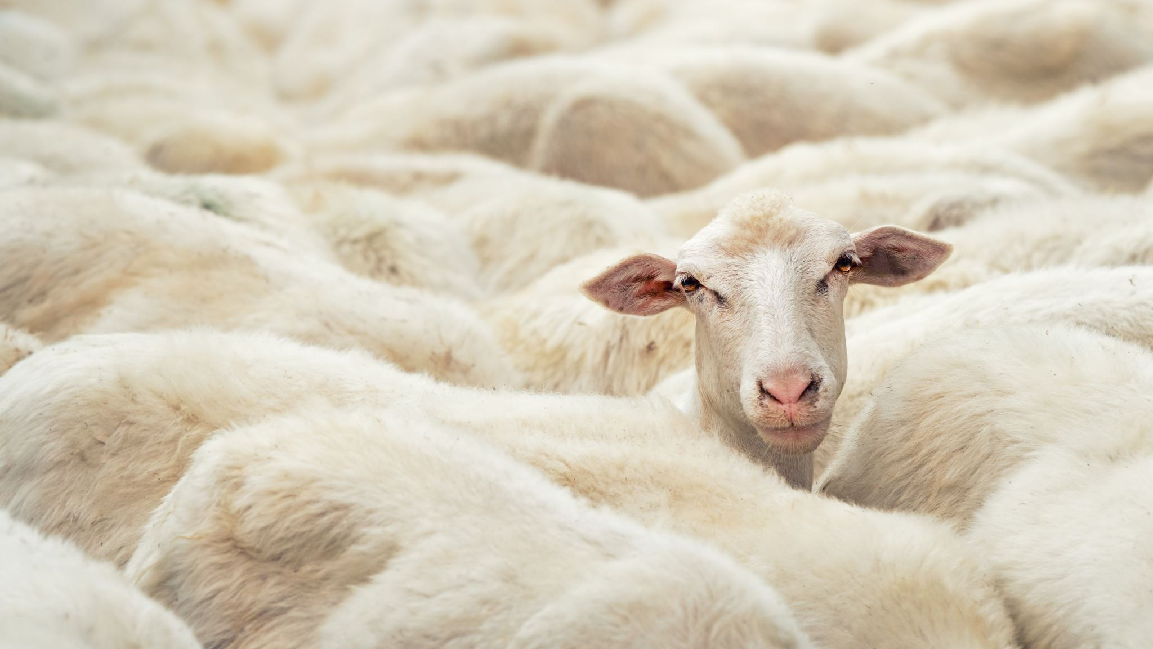
Jesus feeds the hungry
“When he went ashore he saw a great crowd, and he had compassion on them, because they were like sheep without a shepherd. And he began to teach them many things. And when it grew late, his disciples came to him and said, “This is a desolate place, and the hour is now late. Send them away to go into the surrounding countryside and villages and buy themselves something to eat.” But he answered them, “You give them something to eat.” And they said to him, “Shall we go and buy two hundred denarii worth of bread and give it to them to eat?” And he said to them, “How many loaves do you have? Go and see.” And when they had found out, they said, “Five, and two fish.” Then he commanded them all to sit down in groups on the green grass. So they sat down in groups, by hundreds and by fifties. And taking the five loaves and the two fish, he looked up to heaven and said a blessing and broke the loaves and gave them to the disciples to set before the people. And he divided the two fish among them all. And they all ate and were satisfied. And they took up twelve baskets full of broken pieces and of the fish. And those who ate the loaves were five thousand men.”
– Mark 6:34-44

Slide 7
Jesus’ obedience to serve
“Have this mind among yourselves, which is yours in Christ Jesus, who, though he was in the form of God, did not count equality with God a thing to be grasped, but emptied himself, by taking the form of a servant, being born in the likeness of men. And being found in human form, he humbled himself by becoming obedient to the point of death, even death on a cross.”
- Philippians 2:5-8 (ESV)

Slide 8
Section Two
Good Works as our God-given Destiny

Slide 9
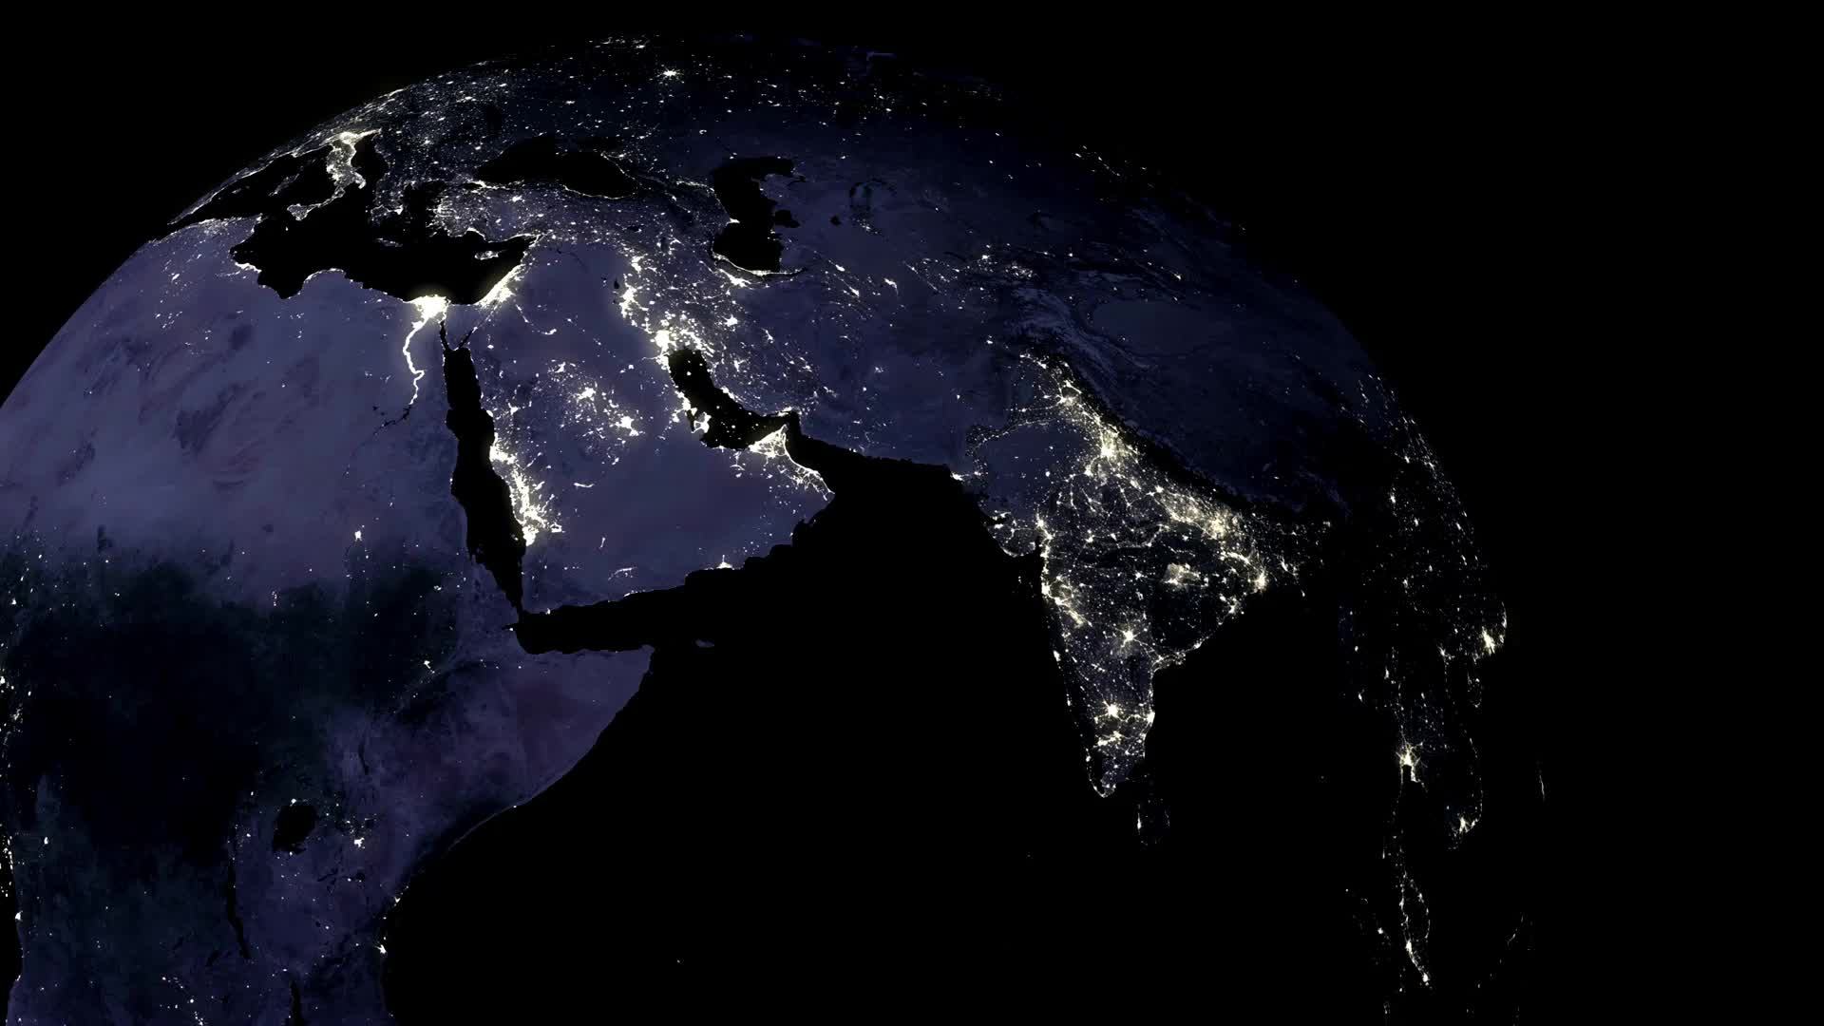
We are salt and light
“You are the salt of the earth…
You are the light of the world.“
- Matthew 5:13a, 14a (ESV)

Slide 10
Created in Christ for Good Works
“Show yourself in all respects to be a model of good works… For the grace of God has appeared, bringing salvation for all people, training us to renounce ungodliness and worldly passions, and to live self-controlled, upright, and godly lives in the present age, waiting for our blessed hope, the appearing of the glory of our great God and Savior Jesus Christ, who gave himself for us to redeem us from all lawlessness and to purify for himself a people for his own possession who are zealous for good works.“
- Titus 2:7a, 11-14 (ESV)
“For we are his workmanship, created in Christ Jesus for good works, which God prepared beforehand, that we should walk in them.“
- Ephesians 2:10 (ESV)

Slide 11
Called to love through action
“By this we know love, that he laid down his life for us, and we ought to lay down our lives for the brothers. But if anyone has the world's goods and sees his brother in need, yet closes his heart against him, how does God's love abide in him? Little children, let us not love in word or talk but in deed and in truth.“
- 1 John 3:16-18 (ESV)

Slide 12
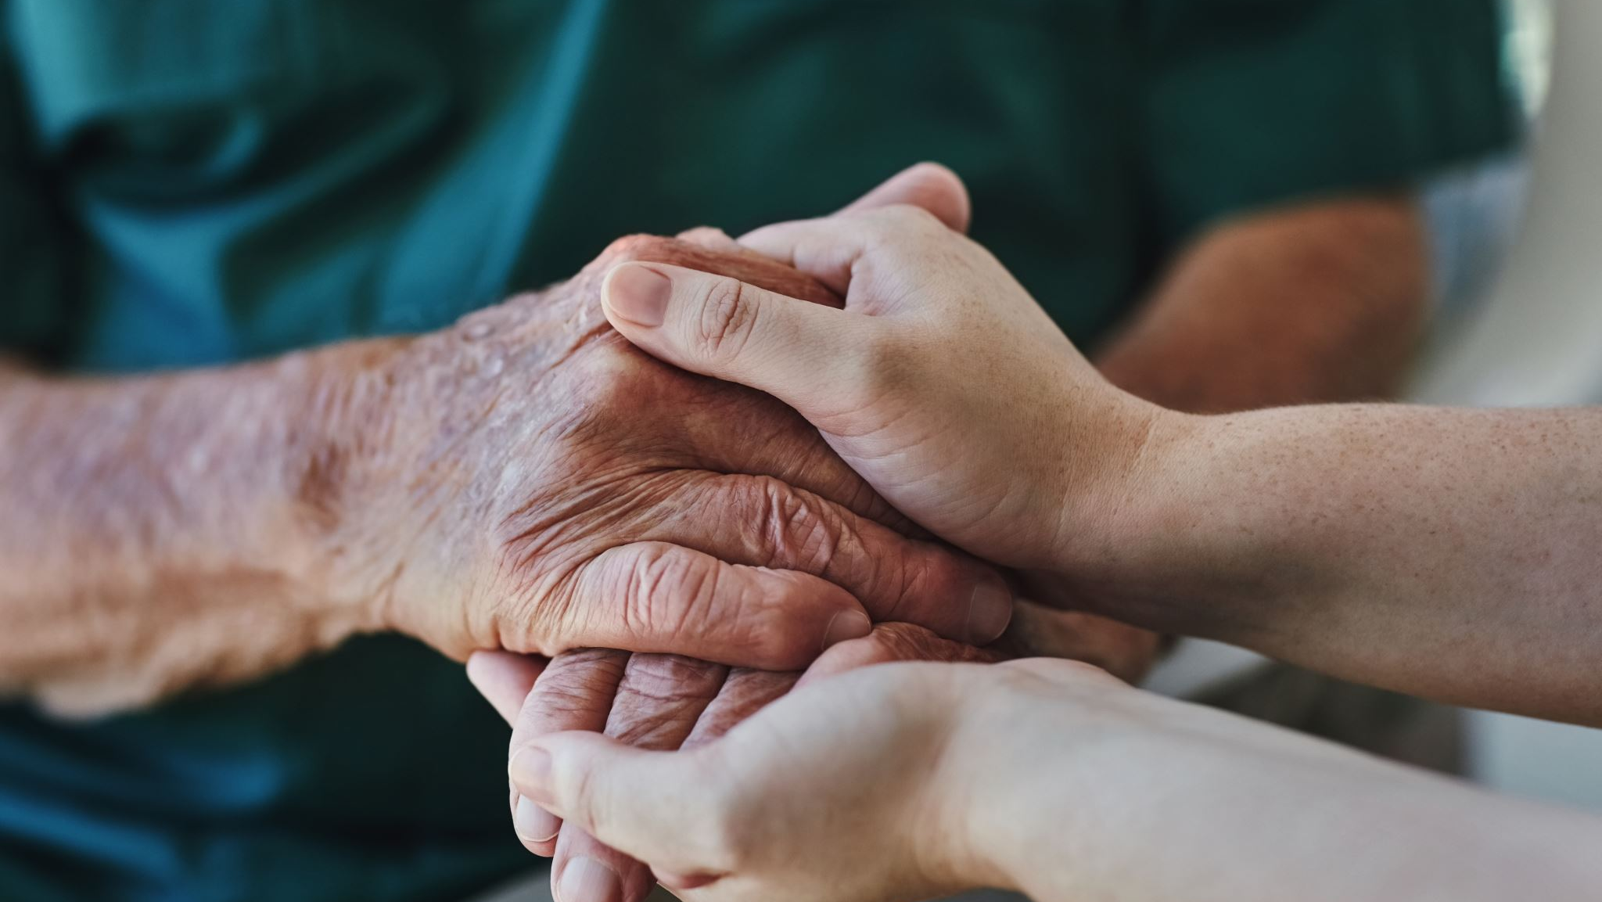
Called to remember the poor
“Only, they asked us to remember the poor,
the very thing I was eager to do.“
- Galatians 2:10 (ESV)

Slide 13
Section Three
The Importance of Good Works

Slide 14
Good Works express and verify our faith
“What good is it, my brothers, if someone says he has faith but does not have works? Can that faith save him? If a brother or sister is poorly clothed and lacking in daily food, and one of you says to them, “Go in peace, be warmed and filled,” without giving them the things needed for the body, what good is that? So also faith by itself, if it does not have works, is dead. But someone will say, “You have faith and I have works.” Show me your faith apart from your works, and I will show you my faith by my works.”
- James 2:14-18 (ESV)

Slide 15
Good Works make us and the Gospel visible
“A city set on a hill cannot be hidden. Nor do people light a lamp and put it under a basket, but on a stand, and it gives light to all in the house. In the same way, let your light shine before others, so that they may see your good works and give glory to your Father who is in heaven.”
- Matthew 5:14b-16 (ESV)

Slide 16
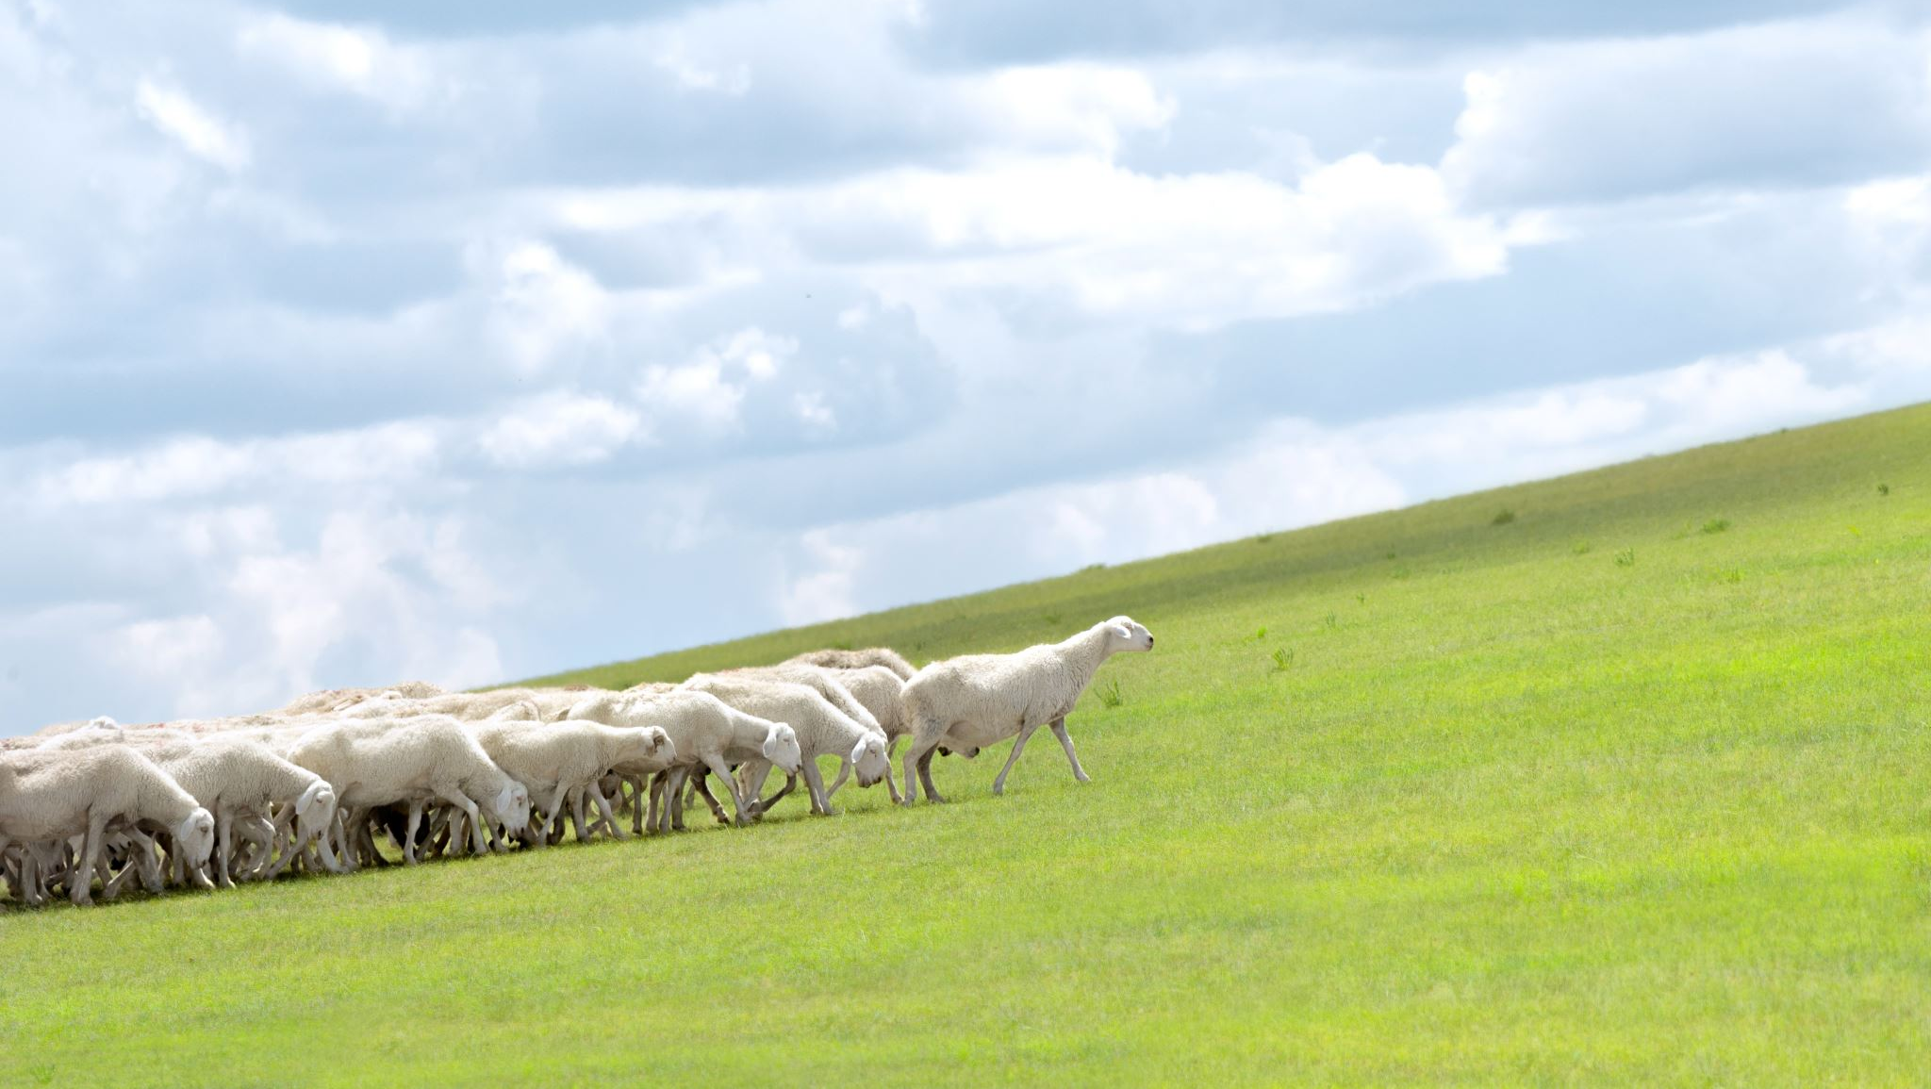
Good Works demonstrate our love for God
“’When the Son of Man comes in his glory, and all the angels with him, then he will sit on his glorious throne. Before him will be gathered all the nations, and he will separate people one from another as a shepherd separates the sheep from the goats. And he will place the sheep on his right, but the goats on the left. Then the King will say to those on his right, ‘Come, you who are blessed by my Father, inherit the kingdom prepared for you from the foundation of the world. For I was hungry and you gave me food, I was thirsty and you gave me drink, I was a stranger and you welcomed me, I was naked and you clothed me, I was sick and you visited me, I was in prison and you came to me.’ Then the righteous will answer him, saying, ‘Lord, when did we see you hungry and feed you, or thirsty and give you drink? And when did we see you a stranger and welcome you, or naked and clothe you? And when did we see you sick or in prison and visit you?’ And the King will answer them, ‘Truly, I say to you, as you did it to one of the least of these my brothers, you did it to me.’”
- Matthew 25:31-40 (ESV)

Slide 17
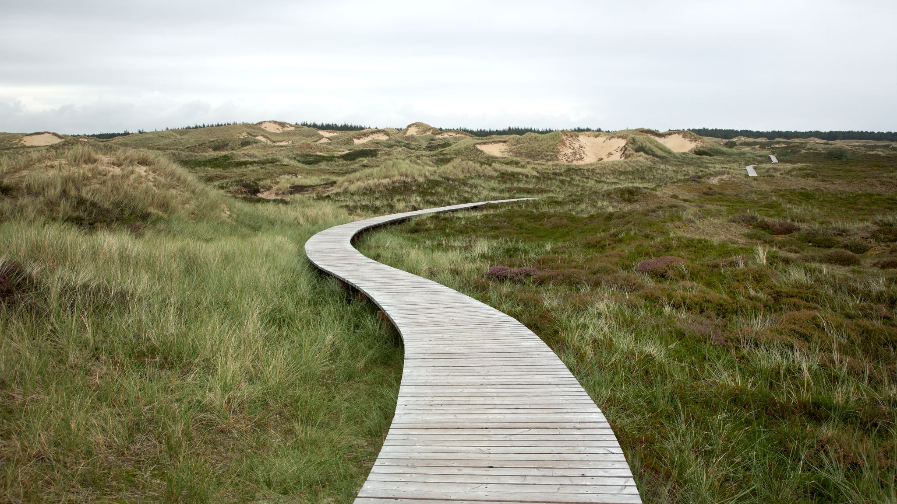
The Great Commission
“Go therefore and make disciples of all nations, baptising them in the name of the Father and of the Son and of the Holy Spirit, teaching them to observe all that I have commanded you.”
- Matthew 28:19-20a (ESV)

Slide 18
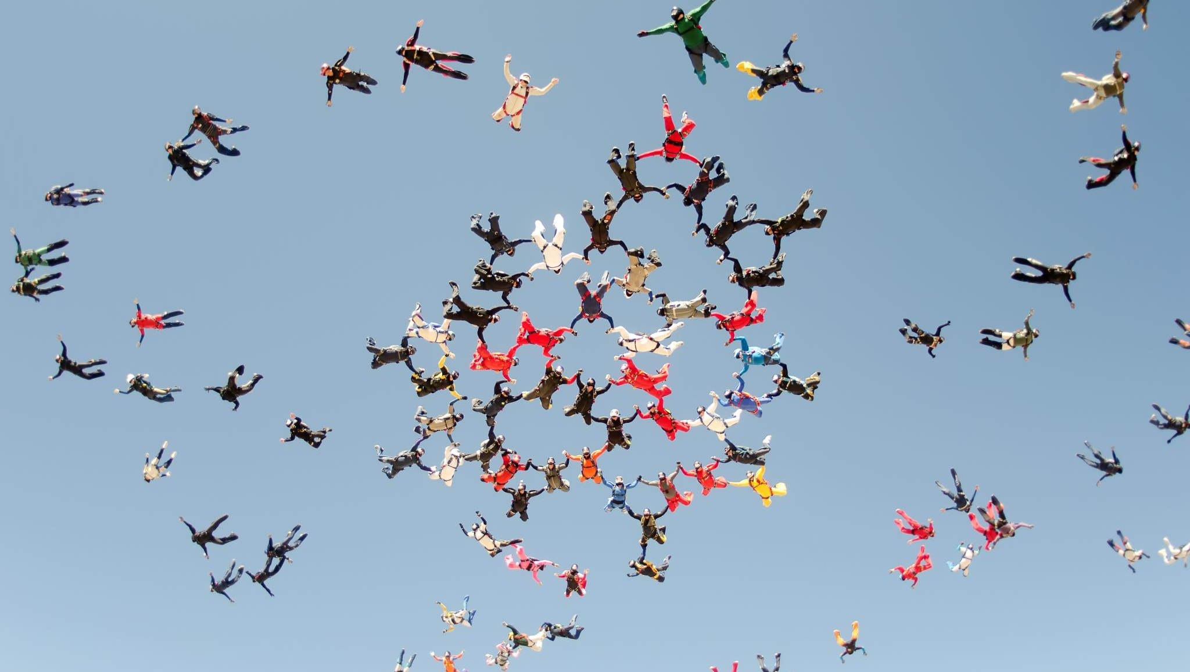
Conclusion

