Slide 1
JESUS AND PRAYER

Slide 2
1. JESUS THE EXAMPLAR OF PRAYER

Slide 3
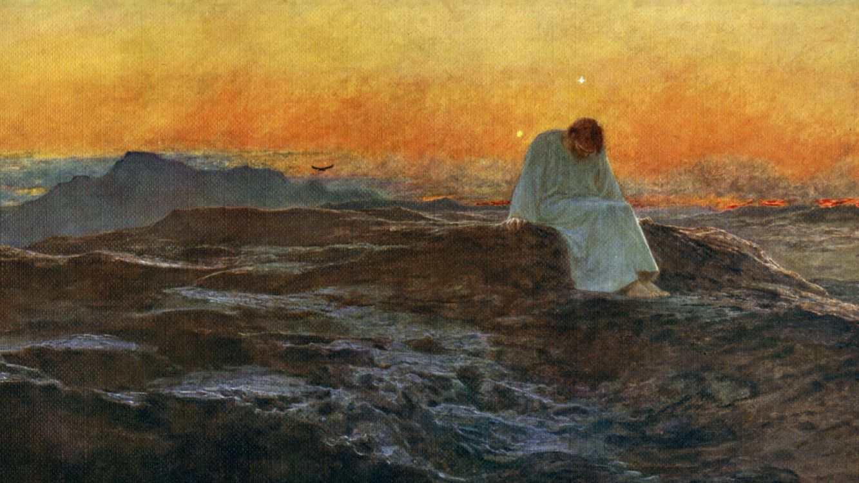
1.1. SOLITUDE: JESUS MAKES ROOM IN HIS BUSY SCHEDULE FOR PRAYER
Luke 4:32; 5:16; 6:12; LUKE 9:28; Matthew 14:23; Mark 6:46)
ESTABLISH A REGULAR PRAYER RHYTHM.
INTRODUCE VARIETY IN PRAYER TO AVOID TEDIUM
DEVELOP A RELATIONSHIP WITH JESUS

Slide 4
1.2. ANOINTING: JESUS PRAYS AND IS EMPOWERED BY THE HOLY SPIRIT: ‘And as he was praying, heaven was opened and the Holy Spirit descended on him in bodily form like a dove (Luke3:21, 22: 11:5-13; Acts 1:14).

Slide 5
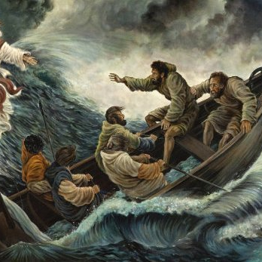
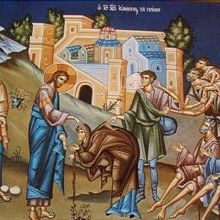
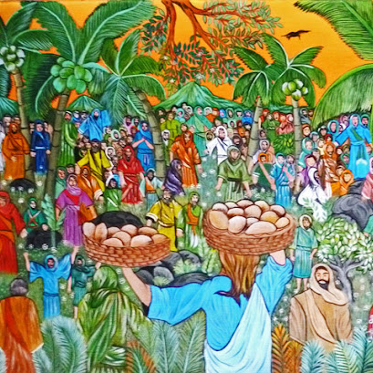
1.3. POWER: JESUS PRAYS AND POWER IS UNLEASHED.
Luke 5: 14-17
Matthew 14:13-36
John 6: 1-21

Slide 6
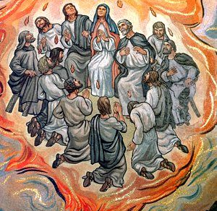
1.4. DECISION-MAKING: JESUS PRAYS AND CHOOSES HIS DISCIPLES
LUKE 6:12-16

Slide 7
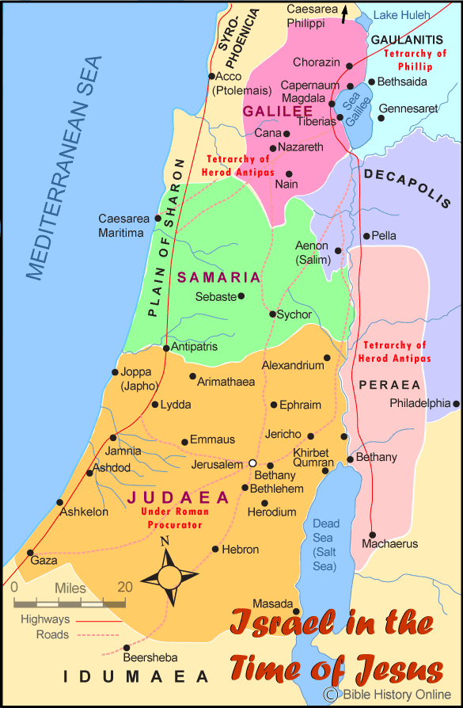
1.5. GUIDANCE: JESUS PRAYS AND EXPANDS HIS MINISTRY ‘Some of us are stuck in religious concrete; we can’t move. Jesus is a demolition expert. When we pray, his explosive power shatters the concrete and sets us free’.
LUKE 4:42-44

Slide 8
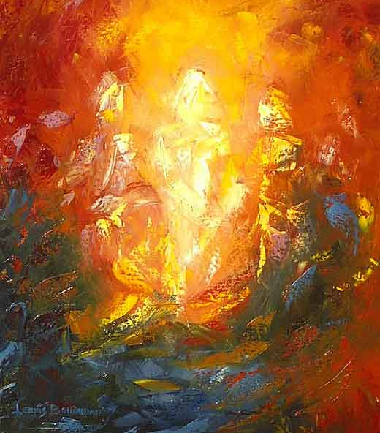
1.6 TRANSFIGURATION: JESUS PRAYS AND IS TRANSFIGURED.
Luke 9:28-36; 2 Corinthians 3:17-18)

Slide 9
1.7. REVELATION: JESUS PRAYS AND PETER RECEIVES A REVELATION THAT JESUS IS THE MESSIAH. LUKE 9:18-20; 2 CORINTHIANS 4:6

Slide 10
1.8. OBEDIENCE: JESUS PRAYS AND SUBMITS TO THE FATHER’S WILL. LUKE 19:39-46; Matthew 26:36-46; Mark 14:32-42; 1 John 5:14-15).

Slide 11
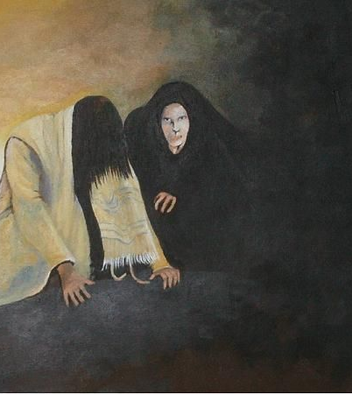
1.8. REFLECTION ON JESUS’ OBEDIENCE TO THE FATHER.
The two great tests Jesus faced came at the beginning and climax of his ministry: his dual with Satan in the wilderness after his baptism and anointing and the agony of obedience in the Garden of Gethsemane before his crucifixion. Both events were tests of his obedience and involved a direct confrontation with Satan (Matthew 4:1-11;Mark 1:12-13; Luke 4:1-13; John 14:30). On both occasions, the battles were fought and won on the battlefield of prayer. After the 40 day fast, Jesus received angelic support, but in Gethsemane he was strengthened by angel during the conflict (Matthew 4:11; Luke 22:43).
The first dual with Satan occurred during 40 days of fasting; the second, shortly after the Passover meal with his disciples.

Slide 12
1.10. INTERCESSION: JESUS PRAYS FOR HIS DISCIPLES LUKE 22:31-35; JOHN 14:16; 17:1-26.

Slide 13
1.10 THE ROOSTER AND THE ROCK
Jesus predicts that Peter will betray him three times before the rooster crows (Matthew 26: 34-35; Mark 14:29-31; Luke 22: 31-44; John 13:36-38).
Jesus wakes Peter three times in Gethsemane (Matthew 26:36-46; Mark 14: 32:40;. ’’Simon,” he said to Peter, “are you asleep? Couldn’t you keep watch for an hour? Watch and pray that you will not fall into temptation. The spirit is willing but the flesh is weak’ (Mark 14:37-39)
Peter betrays Jesus three times (Matthew 26:69-75; Mark 14:66-72; Luke 22:54-62).
Jesus challenges Peter about his love for him three times (John 21:15-19).
Peter’s failure was an excess of self-confidence and a lack of self awareness expressed in his failure to pray. He was sustained and salvaged by the prayers of Jesus. The Lord knew Peter much better than he knew himself: “Simon, Simon, Satan has asked to sift all of you as wheat. But I have prayed for you, Simon, that your faith will not fail. And when you have turned back, strengthen your brothers” (Luke 22:31-32). Significantly, Jesus refers to Peter by his old name, ‘Simon’: “You are Simon (He who has heard), son of John. You will be called Cephas (which, when translated is ‘Peter’ Greek: Petros, the Rock)” (John 1:42).

Slide 14
Rest the brain. Chew over the teaching and digest it. Stretch your muscles.
INTERMISSION

Slide 15
2. JESUS THE TEACHER OF PRAYER. Part 2

Slide 16
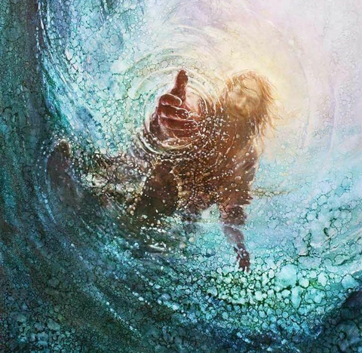
2.1. JESUS TEACHES THAT PRAYER IS RELATIONAL
Matthew 6:9; Romans 8:14-17; John 15:12-15)

Slide 17
4.2. JESUS TEACHES THAT THE MOTIVE OF PRAYER SHOULD BE GOD CENTERED
‘Our Father in heaven
Hallowed be your Name,
Your kingdom come,
Your will be done
On earth as it is in heaven (Matthew 6:9)

Slide 18
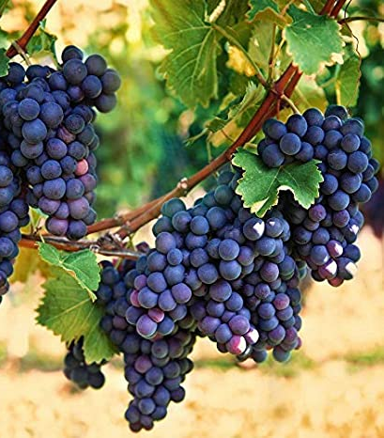
4.3.JESUS TEACHES THAT THE ESSENCE OF PRAYER IS OBEDIENCE.
Matthew 6:10; John 14:23;, 16,17.
‘If you remain in me and my words remain in you, ask whatever you wish, and it will be done for you. This is my Father’s glory, that you bear much fruit, showing yourselves to be my disciples. You did not choose me, but I chose you and appointed you so that you might go and bear fruit - fruit that will last – and so whatever you ask in my name the Father will give you’ (John 15:7,8).

Slide 19
4.4. JESUS TEACHES THAT PRAYER SHOULD BE SPECIFIC AND TO THE POINT.
(Matthew 6:5:13)

Slide 20
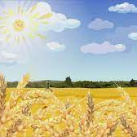
4.5. JESUS TEACHES THAT PRAYER SHOULD BE MISSIONAL
The harvest is plentiful but the workers are few. Ask the Lord of the harvest, therefore, to send workers into his harvest field (Luke 10:2).

Slide 21
4.6. JESUS TEACHES THAT PRAYER SHOULD BE PERSISTENT
The Friend at Midnight (Luke 12:1-13).
The Widow and the Unjust Judge (Luke 18:1-8).

Slide 22
4.7. JESUS TEACHES THAT PRAYER SHOULD BE ACCOMPANIED BY FORGIVENESS
For if you forige other people when they sin against you, your heavenly Father will also forgive you. But if you do not forgive others their sins, your Father will not forgive your sins (Matthew 6:14-15; 18:21-35; Mark 11:215-26; Luke 11:4).

Slide 23
4.8.JESUS TEACHES THAT PRAYER TO THE FATHER SHOULD BE IN HIS NAME
John 14:12,13; 15:16; 16:23,24; Matthew 18:19,20.

Slide 24
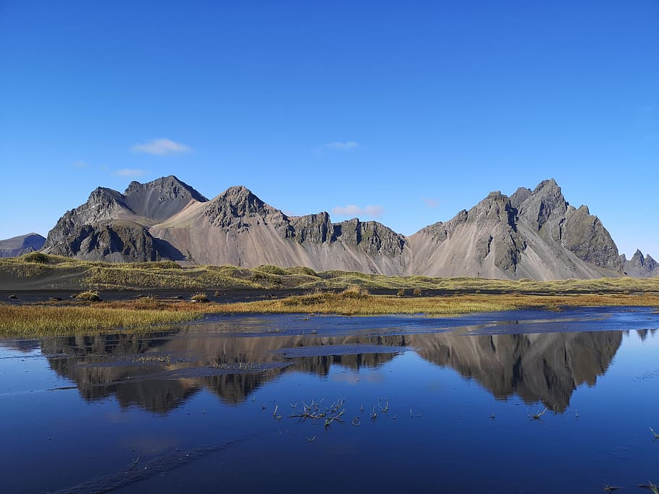
2.9. JESUS TEACHES THAT PRAYER ALIGNED WITH FAITH CAN MOVE MOUNTAINS.
Mark 11:20-25; Matthew 21:19-22

Slide 25
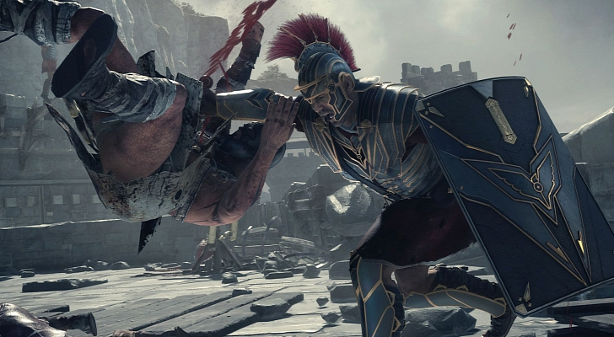
2.10. JESUS TEACHES THAT PRAYER AND FASTING CAN SUBDUE SATAN
Mark 9:29

Slide 26
AN END AND A BEGINNING
Prayer is a threat to Satan’s kingdom and he will do everything to neutralize your prayer life.
Don’t neglect this workshop on prayer and silence the voice of Jesus. He is calling you to a dynamic and fruitful prayer life.
Meditate on Jesus and his life of prayer; look up the Scriptures, read them prayerfully, commit them to memory and pray them into your life.
Remember, an army that advances on its knees never retreats.
Sleep well and wake up early to love, worship and pray to Jesus.

